Slide 1
Crossing Minimisation (1)
Ronald Kieft

Slide 2
Global contents
Specific 2-layer Crossing Minimisation techniques
  After the break, by Johan
Crossing Minimisation survey
  Before the break

Slide 3
Contents
Introduction
2-layer Crossing Minimisation
K-layer Crossing Minimisation
Crossing Minimisation for arbitrary graphs
Other Crossing Minimisation fields

Slide 4
Introduction
What is Crossing Minimisation?
When is it needed?
  Graph drawings are used to give insight into systems and processes
  The better the graph drawing → the more insight
  Most important: edge crossings
    Edge crossings make graph drawings “hard to get”
    Planar vs. Non-planar

Slide 5
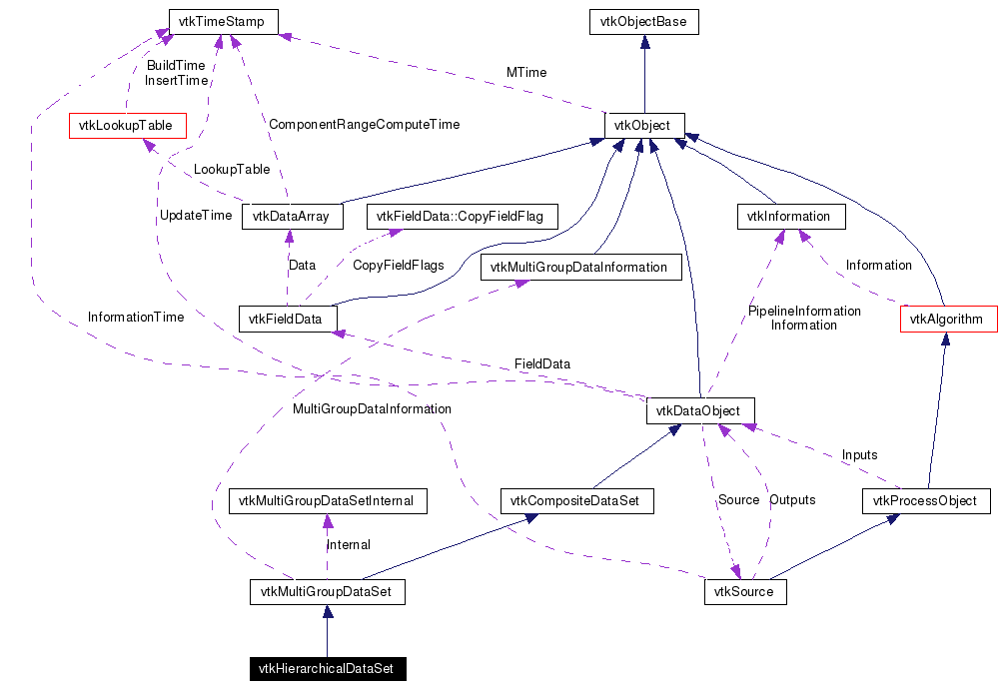
Example

Slide 6
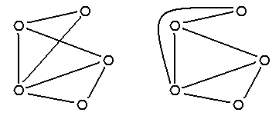
Introduction (cont’d)
Different types of graph drawings
  Type has influence on the # edge crossings
  Crossing Number of a graph
    Minimal # edge crossings
    in any graph drawing
    NP-hard problem
    Over 40 years of research
    Only few results (for special
    types of graphs)
We consider:
  Straight line graph drawings
  Proper layered graphs
    Not a big restriction

Slide 7
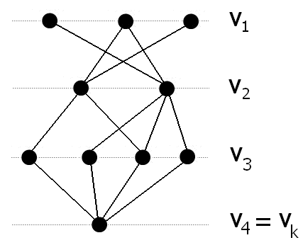
Proper Layered Graph
Layered graph G = (V, E)
  Partition V into k layers: V₁, V₂, …, V_{k}
    With V_{i} ‘intersection’ V_{j} = empty (for i ≠ j)
  Vertices of layer V_{i} drawn on line y = i (or -i)
  All edges in E connect vertices of different layers
Proper layered graph G = (V, E)
  All edges in E connect vertices of neighboring layers
Property:
  Order of vertices within each layer determines the number of edge crossings

Slide 8
2-layer Crossing Minimisation
Layered graphs with only 2 layers
  Bipartite graphs
Two variants:
  Vertices of only one layer are repositioned (1-sided)
  Vertices of both layers are repositioned (2-sided)
1-sided 2-layer Crossing Minimisation Problem:
  Given a bipartite graph G = (V₁, V₂, E) and an ordering x₁ of vertices V₁, find an ordering x₂ of vertices V₂, such that the number of edge crossings of G is minimized
2-sided 2-layer Crossing Minimisation Problem:
  Given a bipartite graph G = (V₁, V₂, E), find orderings x₁ and x₂ of vertices V₁ and V₂, such that the number of edge crossings of G is minimized

Slide 9
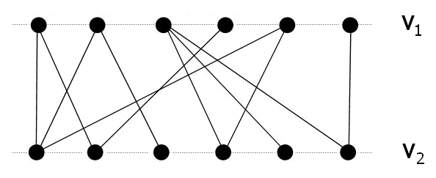
Example

Slide 10
2-layer Crossing Minimisation
1-sided variant is NP-hard
  Proof: after the break by Johan
  As a result, the problem can be solved using heuristics
    Several heuristics will be described by Johan
What is left for me?
  Extension from 2 to k layers
  Transform arbitrary graphs to layered graphs
  Briefly discuss other Crossing Minimisation fields

Slide 11
K-layer Crossing Minimisation
k-layer Crossing Minimisation Problem:
  Given a proper k-layered graph G = (V₁,…, V_{k}, E), find orderings x₁,…, x_{k} of vertices V₁,…, V_{k}, such that the number of edge crossings of G is minimized
General way to solve:
  Choose a heuristic for the 1-sided 2-layer Crossing Minimisation problem
  Use this heuristic in a so-called Layer-by-layer sweep

Slide 12
K-layer Crossing Minimisation
Layer-by-layer sweep
  Converts an instance of the k-layer problem to multiple instances of the 1-sided 2-layer problem
  Each instance is solved using the selected heuristic
  The result of solving one instance, is used to solve other instances

Slide 13
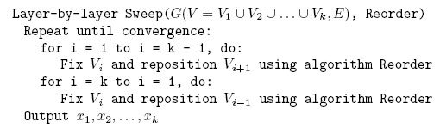
K-layer Crossing Minimisation
Layer-by-layer sweep algorithm:

Slide 14
Example

Slide 15
K-layer Crossing Minimisation
When do you stop sweeping?
  When no more improvements are made
    No good
  Fixed amount of iterations
  Using a forgiveness number

Slide 16
Crossing Minimisation for arbitrary graphs
Two types of graphs:
  Undirected graphs
  Directed graphs
    Directed Acyclic graphs (DAG’s)
  Assumption: graphs are connected
Undirected graphs and DAG’s can be transformed into layered graphs
  Unfortunately, cyclic directed graphs can not
  General idea: assign a rank to each vertex
Layered graphs can be made proper

Slide 17
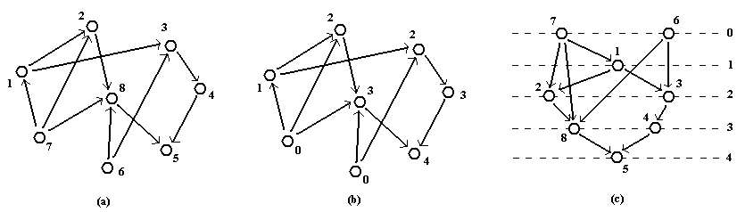
Directed acyclic to layered
Length of the longest incoming path determines the rank
Can not be used for graphs with cycles
  Certain edges will point upwards

Slide 18
Undirected to layered
Definitions:
  Distance d(x, y): shortest path between x and y
  Number e(x): max d(x, y) over all y
  Center: the vertex which has the lowest value for e(x), this value is r (radius of the graph)
Based on the definitions, a rank can be assigned:
  Rank(x) = r – e(x)

Slide 19
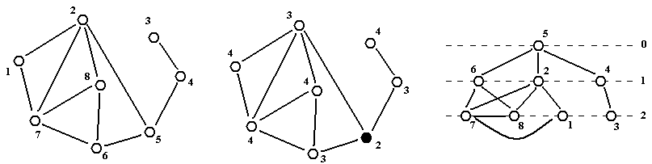
Example

Slide 20
Undirected to layered
Problem:
  Technique gives a Hierarchical graph
  Hierarchical graph can have flat edges
Problem can be solved by iteratively inserting new layers, and shifting vertices down

Slide 21
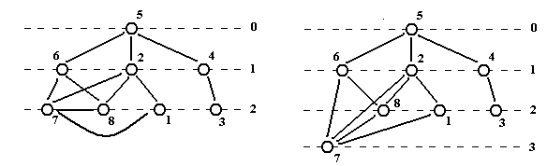
Example

Slide 22
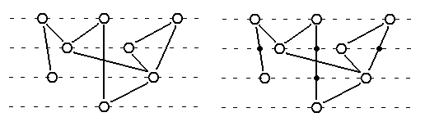
Layered to proper layered
Both techniques give layered graphs
  Still have to be made proper
Recall
  So, long edges have to be made short
  Can be done by inserting dummy vertices

Slide 23
Further optimizing the drawing
Crossing Minimisation tries to optimise the graph
  Reducing edge crossings is not the only important aspect
  Dummy vertices make results worse
Therefore, horizontal coordinate assignment
  Post-processing strategy
  Another minimisation problem

Slide 24
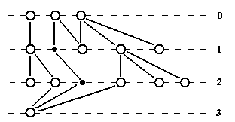
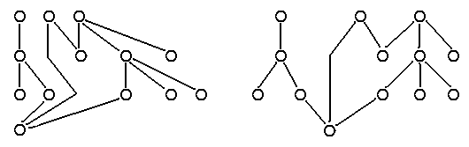
Examples

Slide 25
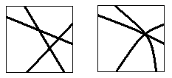
Other Crossing Minimisation fields
General approach:
  Reduce edge crossings because they are bad
  Try to minimise the number of edge crossings
    Discussed version: only allow straight edges
    Variant: allow curved edges
      Multiple edge crossings can convert into a single one
      Less edge crossings
Another approach:
  Edges causing edge crossings are bad
  Try to minimise the number of edges causing edge crossings
    Planarization approach

Slide 26
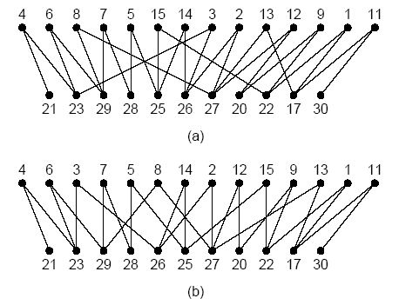
Planarization approach
Justification of this motivation

Slide 27
Planarization approach
Justification of the motivation
  (a): 34 edge crossings
  (b): 24 edge crossings

Slide 28
Planarization approach
Definitions, using G = (V, E):
  Planar graph: can be drawn without edge crossings
  Maximal planar subgraph of G:
    Partitioning of E into sets M and N
    V together with M induces a planar subgraph
    Adding any edge of N will make the subgraph non-planar
  Maximum planar subgraph of G:
    Over all possible maximal planar subgraphs of G, the one with the highest cardinality of set M

Slide 29
Planarization approach
Finding a Maximum planar subgraph is NP-hard
  Again, need for heuristics
Planarization approach consists out of two steps:
  Step 1: compute maximal planar subgraph
  Step 2: re-insert “left-out” edges

Slide 30
Planarization approach
Step 1: Compute maximal planar subgraph
  Many heuristics exists
  Incremental heuristic
Local optimisation can be used
  Improves the result of most heuristics

Slide 31
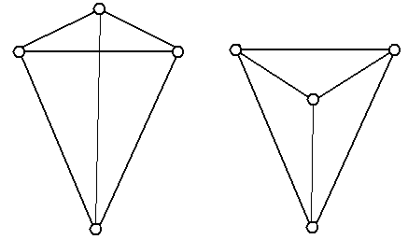
Planarization approach
Step 2: re-insert edges
  Order of insertion does
  not matter
  Embedding maximal planar
  subgraph does matter
  Polynomial time algorithm exists to find the “best” embedding
    Select an edge
    Find the “best” embedding
    Insert edge and make subgraph planar again

Slide 32
Summary
Crossing Minimisation is NP-hard
Many variants and many approaches
Applied to obtain “nice” graph drawings
After the break:
  Proof that Crossing Minimisation is NP-hard
  Heuristics for 1-sided 2-layer Crossing Minimisation
  Performance comparison of the heuristics

Slide 33

Questions

